Slide 1
Pythagoras’ Theorem
A plane flies 120km due north, and then heads due east for 80km. How far is the plane from it’s starting point?
80km
How do we calculate the final distance?
120km

Slide 2
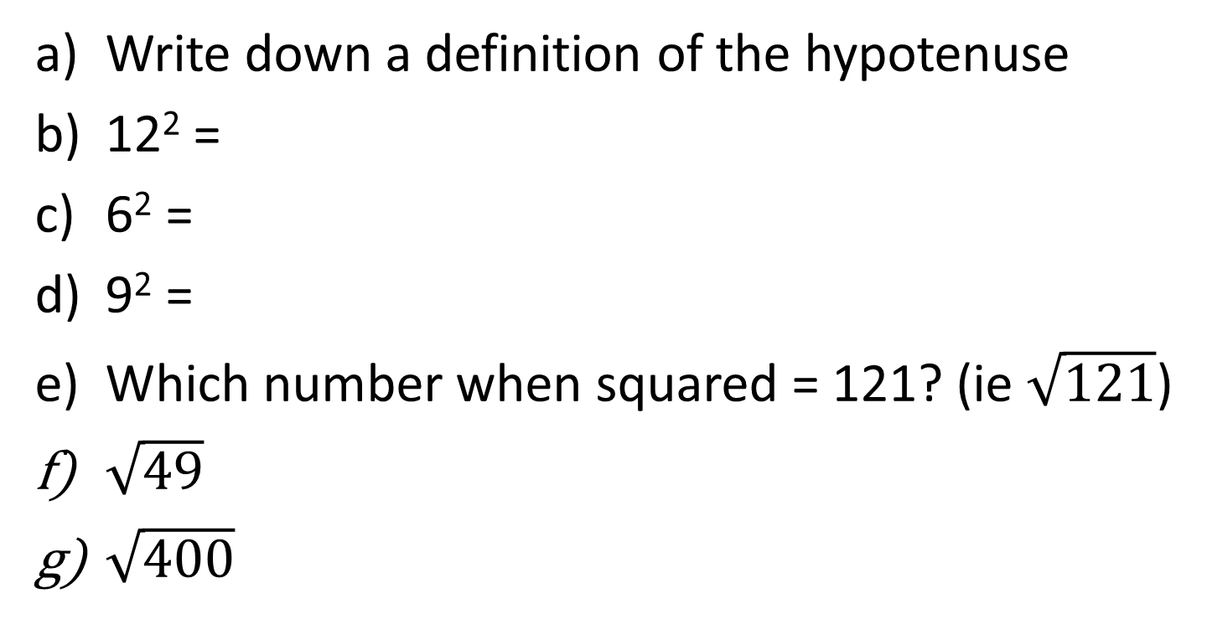
Starter
Write down a definition of the hypotenuse
12² =
6² =
9² =
Which number when squared = 121? (ie $\sqrt{121}$)
$\sqrt{49}$
$\sqrt{400}$

Slide 3

Pythagoras’ Theorem
11/03/11
Learning Objectives:
Be able to find the hypotenuse using
Pythagoras
Be able to apply your knowledge to
worded problems

Slide 4
Topic : Pythagoras
24
7
30
Date
EQ : How do you use Pythagoras to find the lengths of sides?
c² = a² + b²
Square both the non-hypotenuse sides
Add the results together
Square root your answer to find the length of the hypotenuse
How do you find the length of the longer side?
How do you find the length of the Shorter side?
We can also use Pythagoras’ theorem to find the length of a shorter
a² = c² – b²
Square the longer side
Subtract the square of the other known side
Square root your answer to get the unknown shorter side

Slide 5
Pythagoras’ Theorem
Example
Find the length of the hypotenuse.
c² = a² + b²
c² = 15² + 23²
c² = 225 + 529
c² = 754
c = √754
c = 27.46cm
c
15cm
23cm
Notes:
Example

Slide 6
Pythagoras’ Theorem
a² = c² - b²
a² = 13² - 12²
a² = 169 - 144
a² = 25
a = √25
a = 5 cm
13cm
12cm
a

Slide 7
Pythagoras’ Theorem
Find the length of the missing side
3m
25m

Slide 8
Pythagoras’ Theorem
6cm
b
14cm

Slide 9
Pythagoras’ Theorem
c
18cm
4m
Notes:
Guided practice

Slide 10
Pythagoras’ Theorem
c
13cm
10cm
Notes:
Guided practice

Slide 11


Calculate the length of the diagonal BC.
The diagram shows a trapezium ABCD . Calculate the length of CD.
1
2
3
14.76cm
20cm
8.60cm
16cm
B
A
10cm
C
A
h
12cm
7cm
7cm
C
D
B
15cm
D
13cm
A ladder leans against a wall 4m tall with one end on the ground 6m from the wall. The other end just reaches a windowsill. Calculate the length of the ladder.
4
5
21.10m
6
7.21m
8.06cm
4cm
18m
h
7cm
4m
h
11m
6m
7
8
9
8.54cm
8.49m
15.65cm
h
3cm
h
6m
14cm
h
8cm
6m
7cm
Notes:
Can be used for more guided practice questions.

Slide 12
Pythagoras’ Theorem
hypotenuse
3cm
a)
4cm
Measure the lengths of the sides in the four triangles below and use this information to complete the table underneath.
a
c
c
b)
a
c)
b
b
a
c
d)
c
a
e)
b
b
Triangle | Short side a | Short side b | Hypotenuse c | a² | b² | c²
a) | 3 | 4 | 5 | 9 | 16 | 25
b)
c)
d)
e)
Notes:
Independent practice – worksheet to be printed out

Slide 13
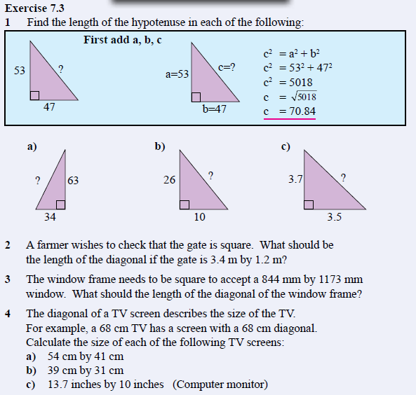
Exercise 7.3 Page 92
Notes:
Alternative / additional Independent practice

Slide 14
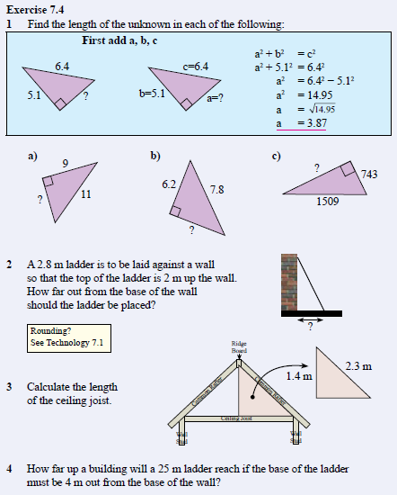
Exercise 7.4 Page 92

Slide 15
Pythagoras’ Theorem
A plane flies 120km due north, and then heads due east for 80km. How far is the plane from it’s starting point?
80km
c² = a² + b²
c² = 120² + 80²
c² = 14400 + 6400
c² = 20800
c = √20800
c = 144.22km (2dp)
120km

Slide 16
Pythagoras’ Theorem Exit pass
Find the length of the missing sides
10m
10m
8m
12 m
Notes:
Exit pass

